Slide 1
Kupongo System/Algorithm Design and Analysis
Kupongo Team

Slide 2
The Opportunity: Coupon Gamification
Goals: Offer higher value coupons
Create an interactive user experience
Influence customer turnout
Respond in real time to local market needs
Approach: Customized virtual coupons pinned to GPS locations on an urban ‘gameboard’ to be collected by customers walking down the street.
Notes:
Nathan

Slide 3
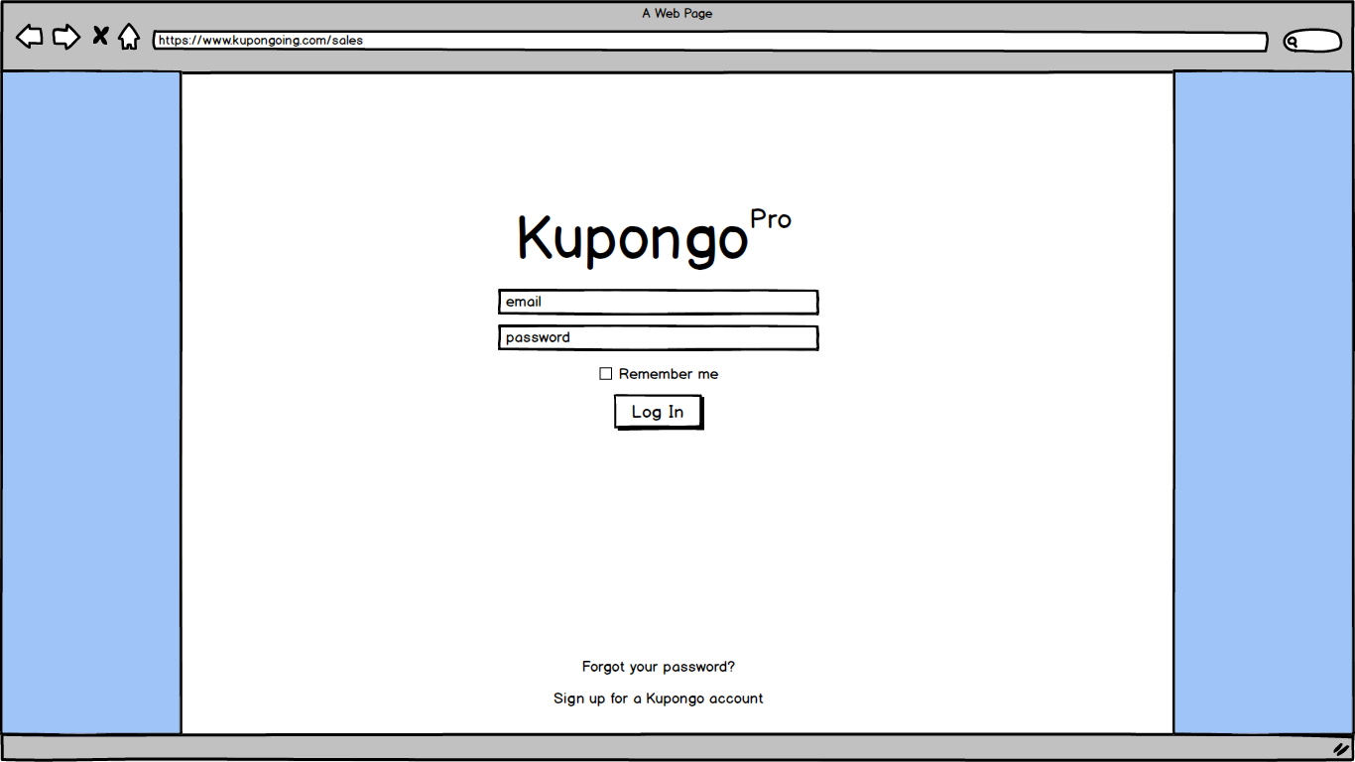
Notes:
Kevin
Sales Executive Login view

Slide 4
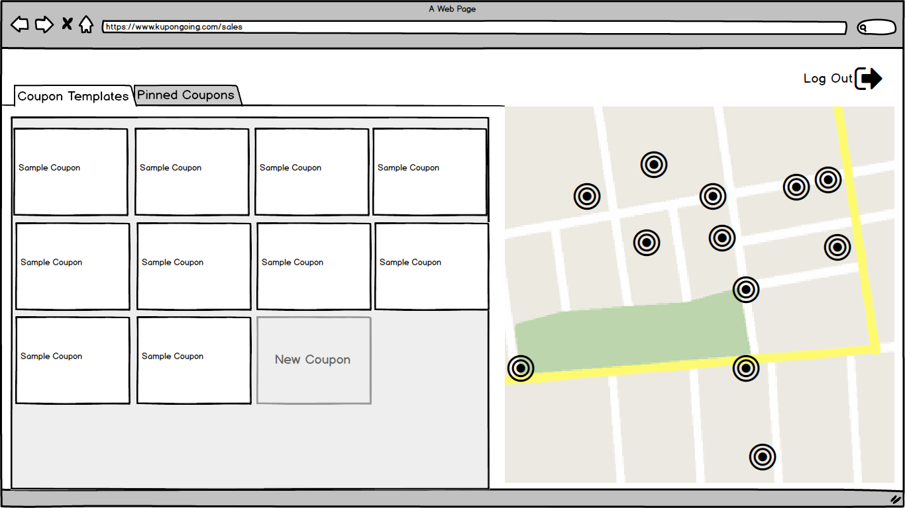
Notes:
Kevin
Home screen, coupon templates view

Slide 5
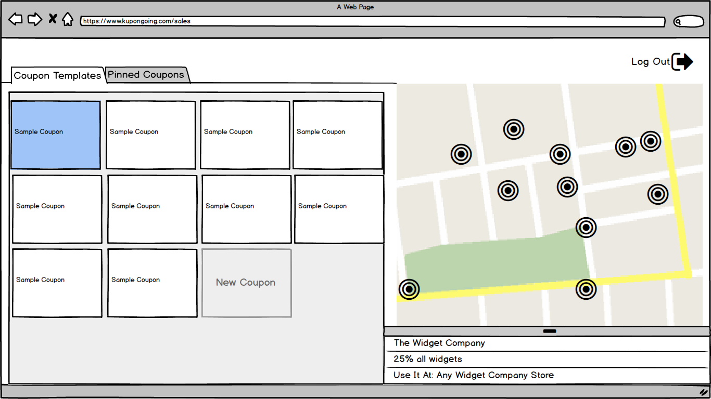
Notes:
Kevin
Mini detail of a selected template

Slide 6
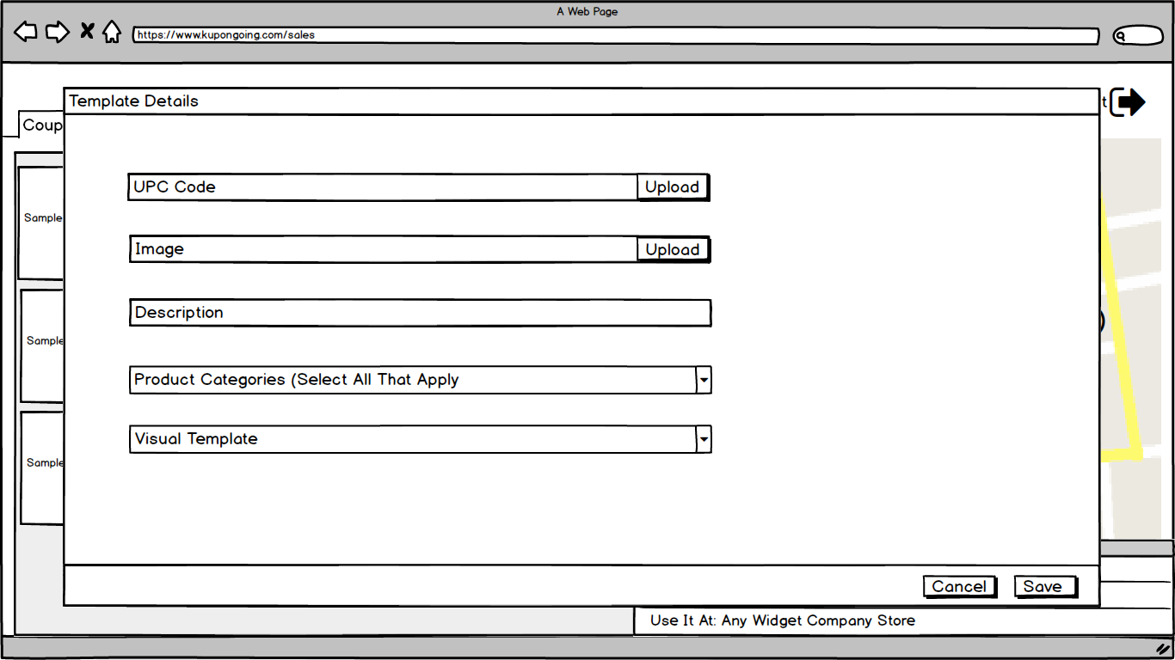
Notes:
Kevin
Full detail popup view of selected template

Slide 7
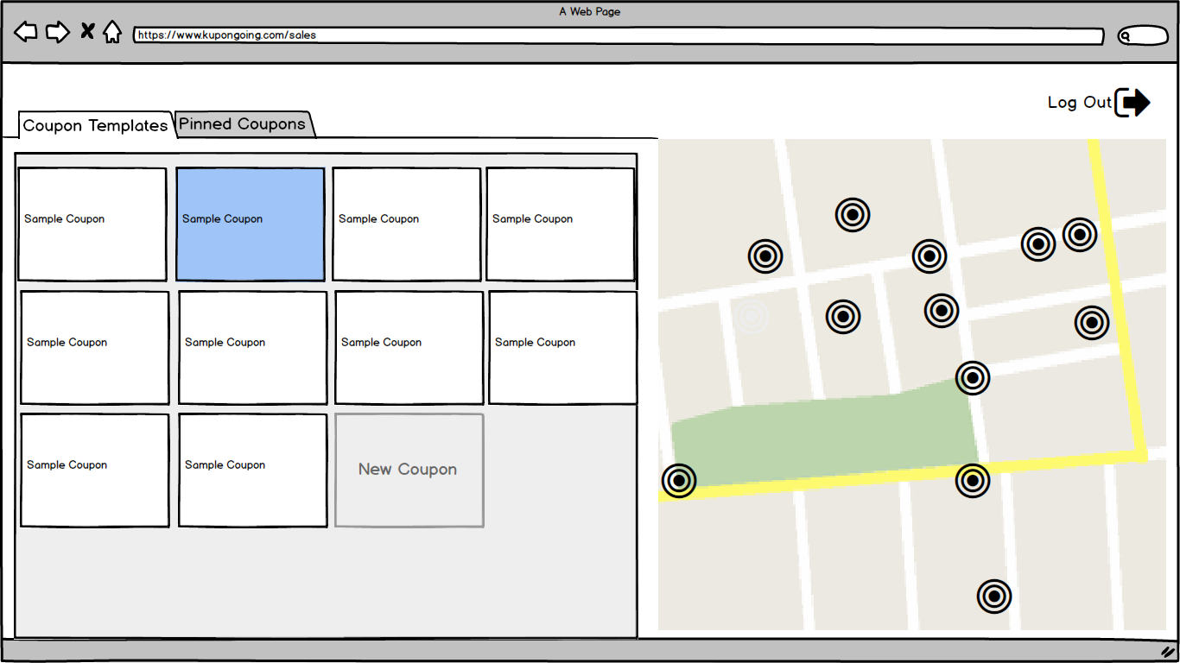
Notes:
Melvin

Slide 8
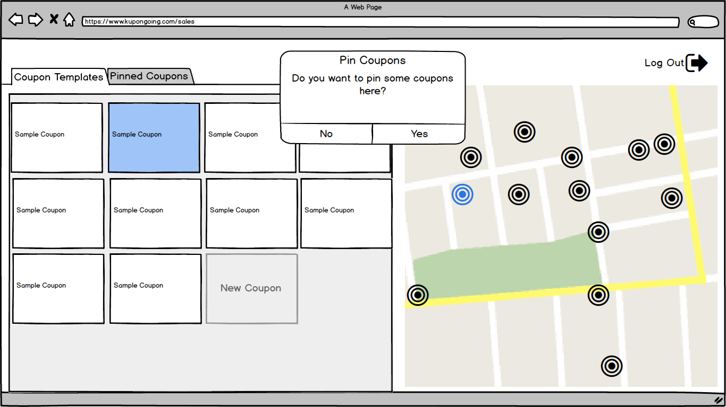
Notes:
Melvin

Slide 9
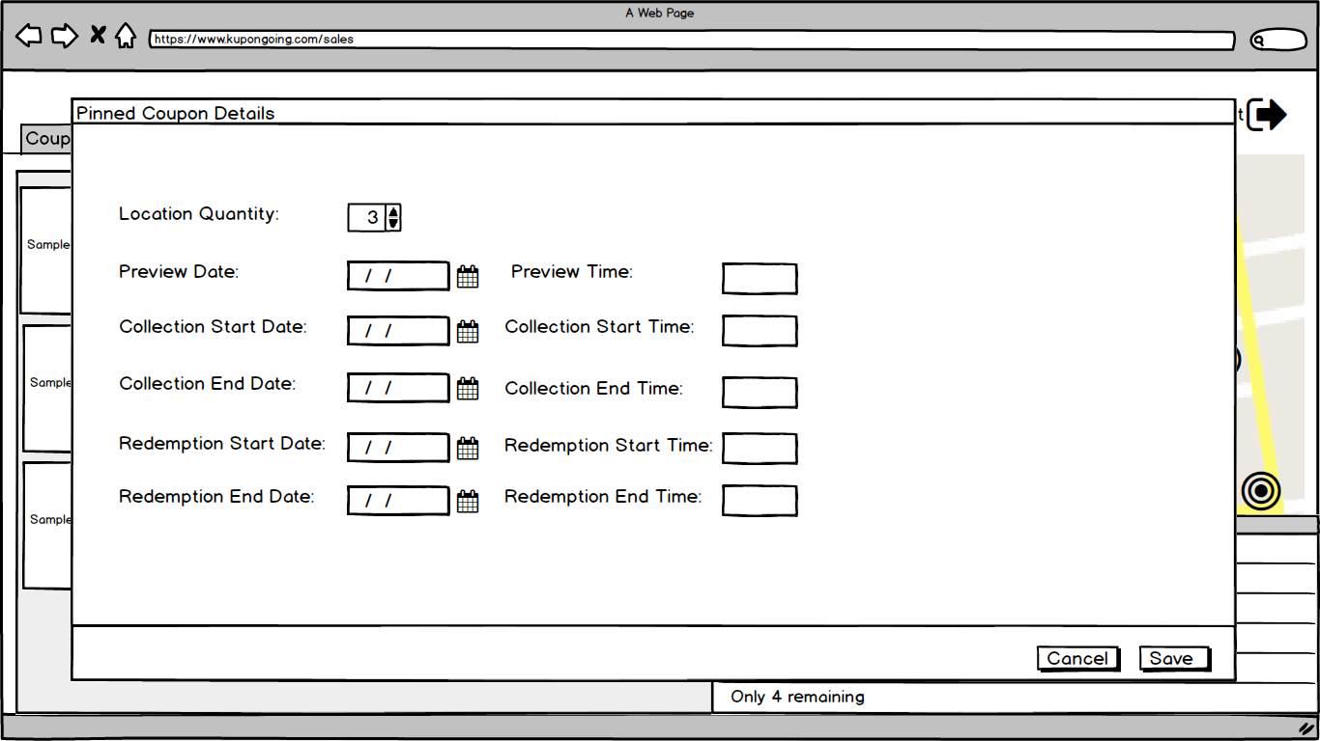
Notes:
Melvin

Slide 10
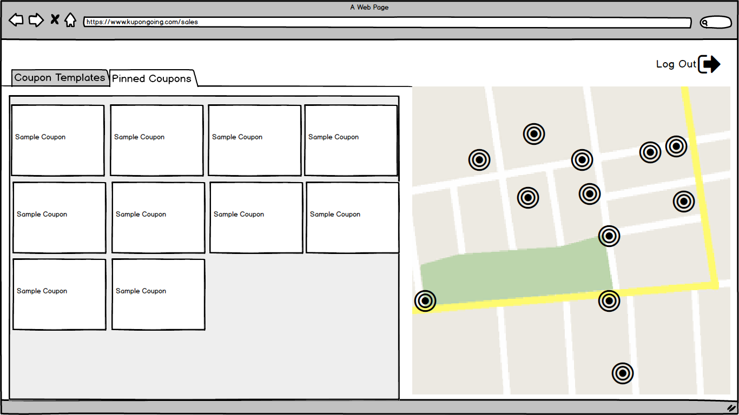
Notes:
Nathan

Slide 11
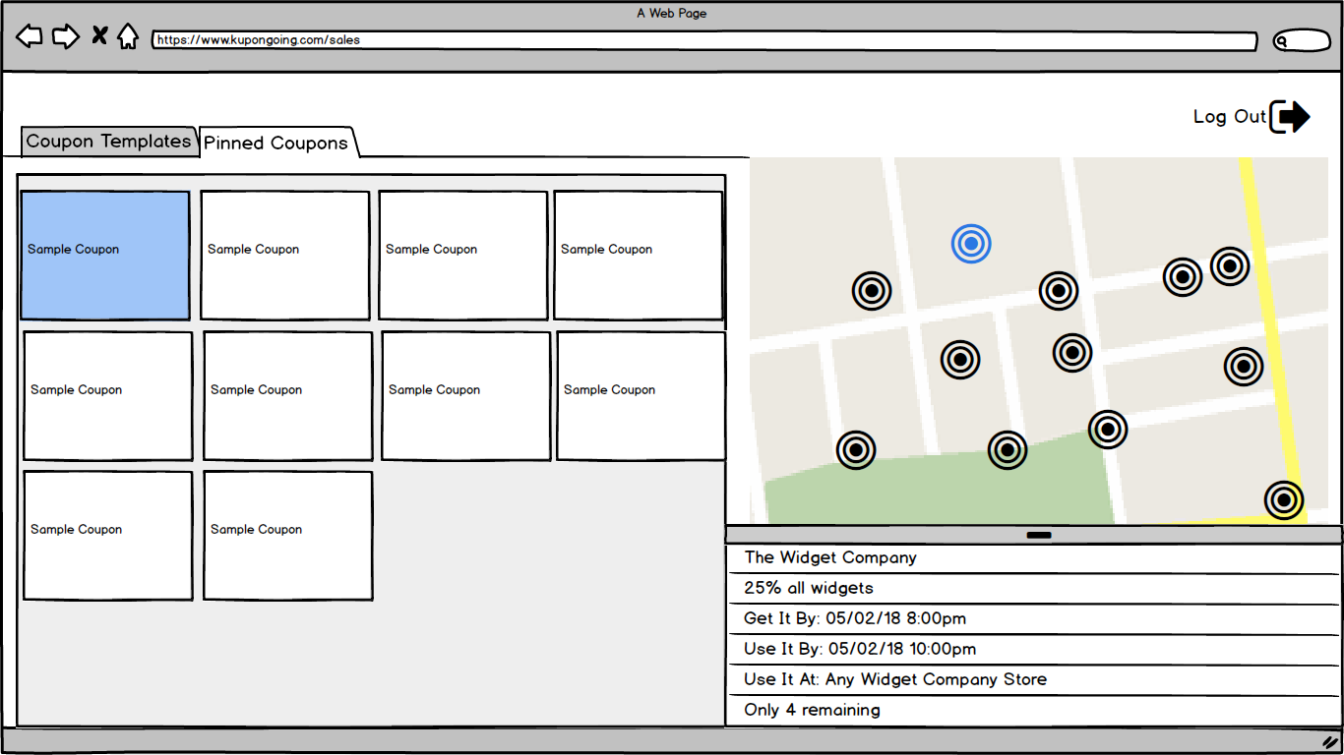
Notes:
Nathan

Slide 12
Notes:
Nathan

Slide 13
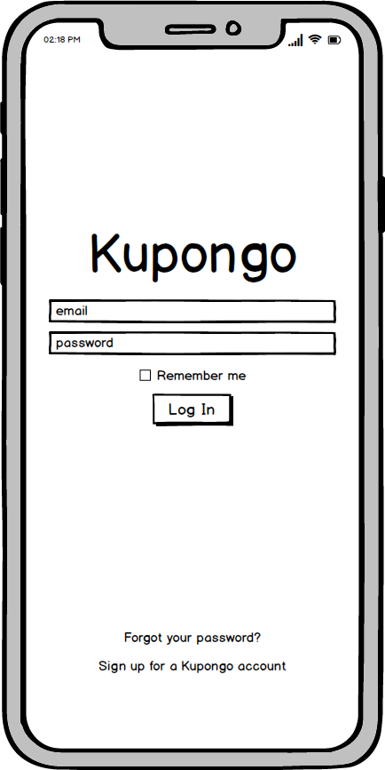
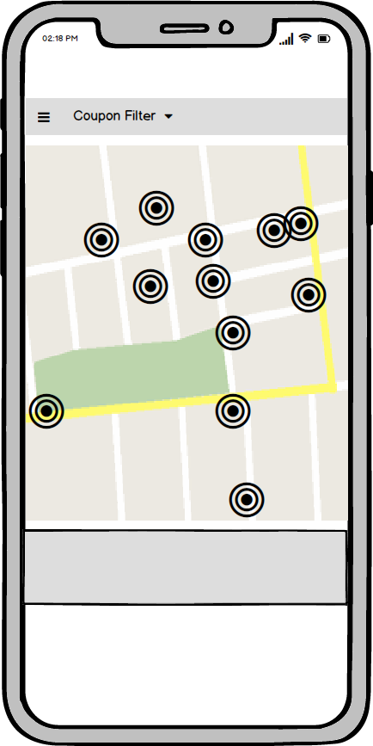
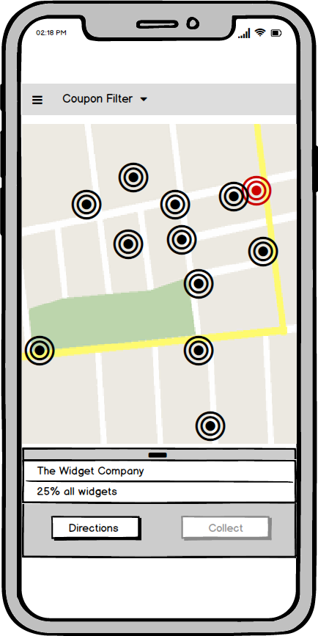
Notes:
David

Slide 14
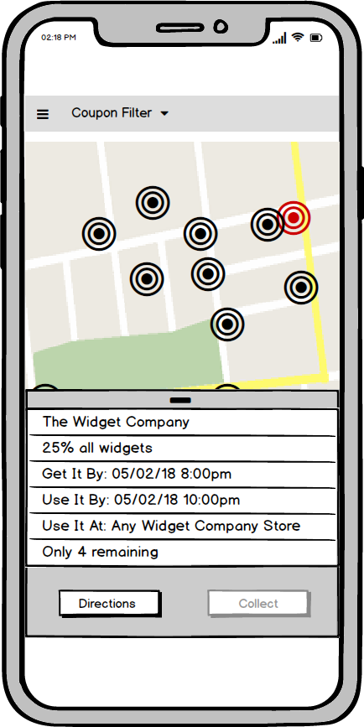
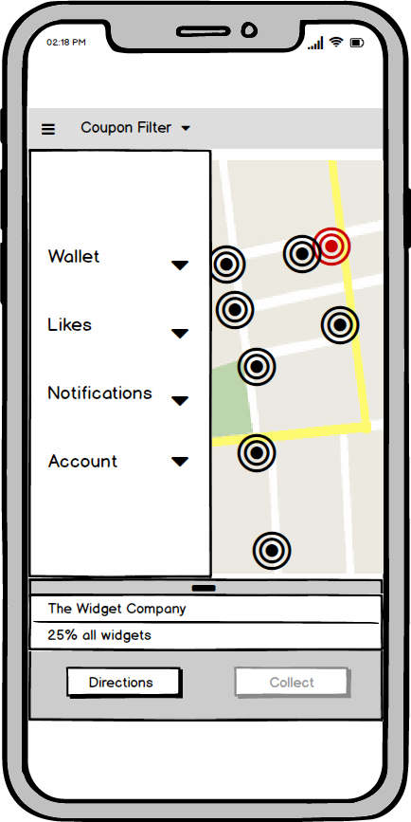
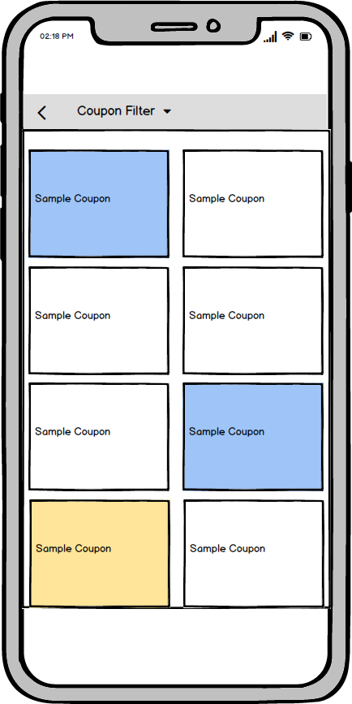
Notes:
David

Slide 15
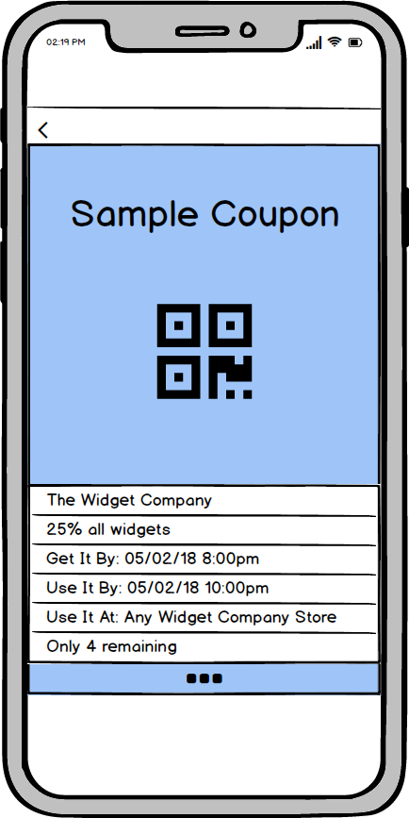
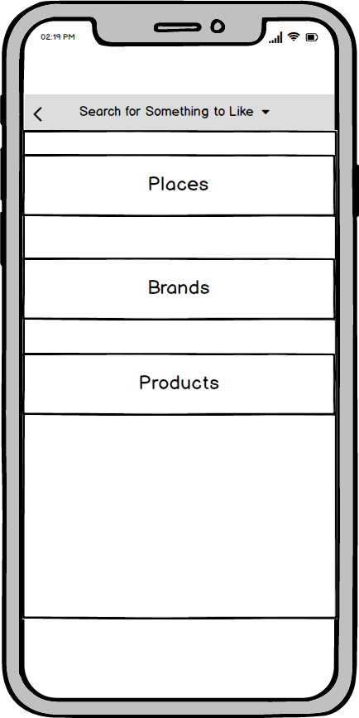
Notes:
David

Slide 16
Detailed requirements - Functionality
Customer functionality:
Create account or login into existing account
View GPS locations of coupons in proximity
Receive notifications when new coupons are available
View coupon details
Get directions to coupons
Collect coupons
Redeem coupons at retailer
Notes:
Melvin, I can do the functionality requirements unless someone else wants too?

Slide 17
Detailed requirements - Functionality Cont.
Business functionality:
Create business account or login into existing business account
Create customized coupon templates
Pin multiple coupons at once or multiple instances of one coupon
View information about coupon templates and where they are placed
Information about coupon collection and redemption
Remove or modify coupon instance
Notes:
Melvin, I can do the functionality requirements unless someone else wants too?

Slide 18
Detailed Requirements - Usability
Customer interface:
Account information
Coupon wallet
Favorite businesses, products, and brands
Business interface:
Save coupon information for templates
Pin coupons individually
Pin multiple instances of the same coupon
Notes:
David - I’ll take this

Slide 19
Detailed Requirements - System & Security
Software:
Mobile interface for customer
Web interface for businesses
Live database
Security:
Protect user information (Name, contact info., etc.)
Prevent coupon fraud (GPS spoofing, Screenshots)
Notes:
Preston

Slide 20
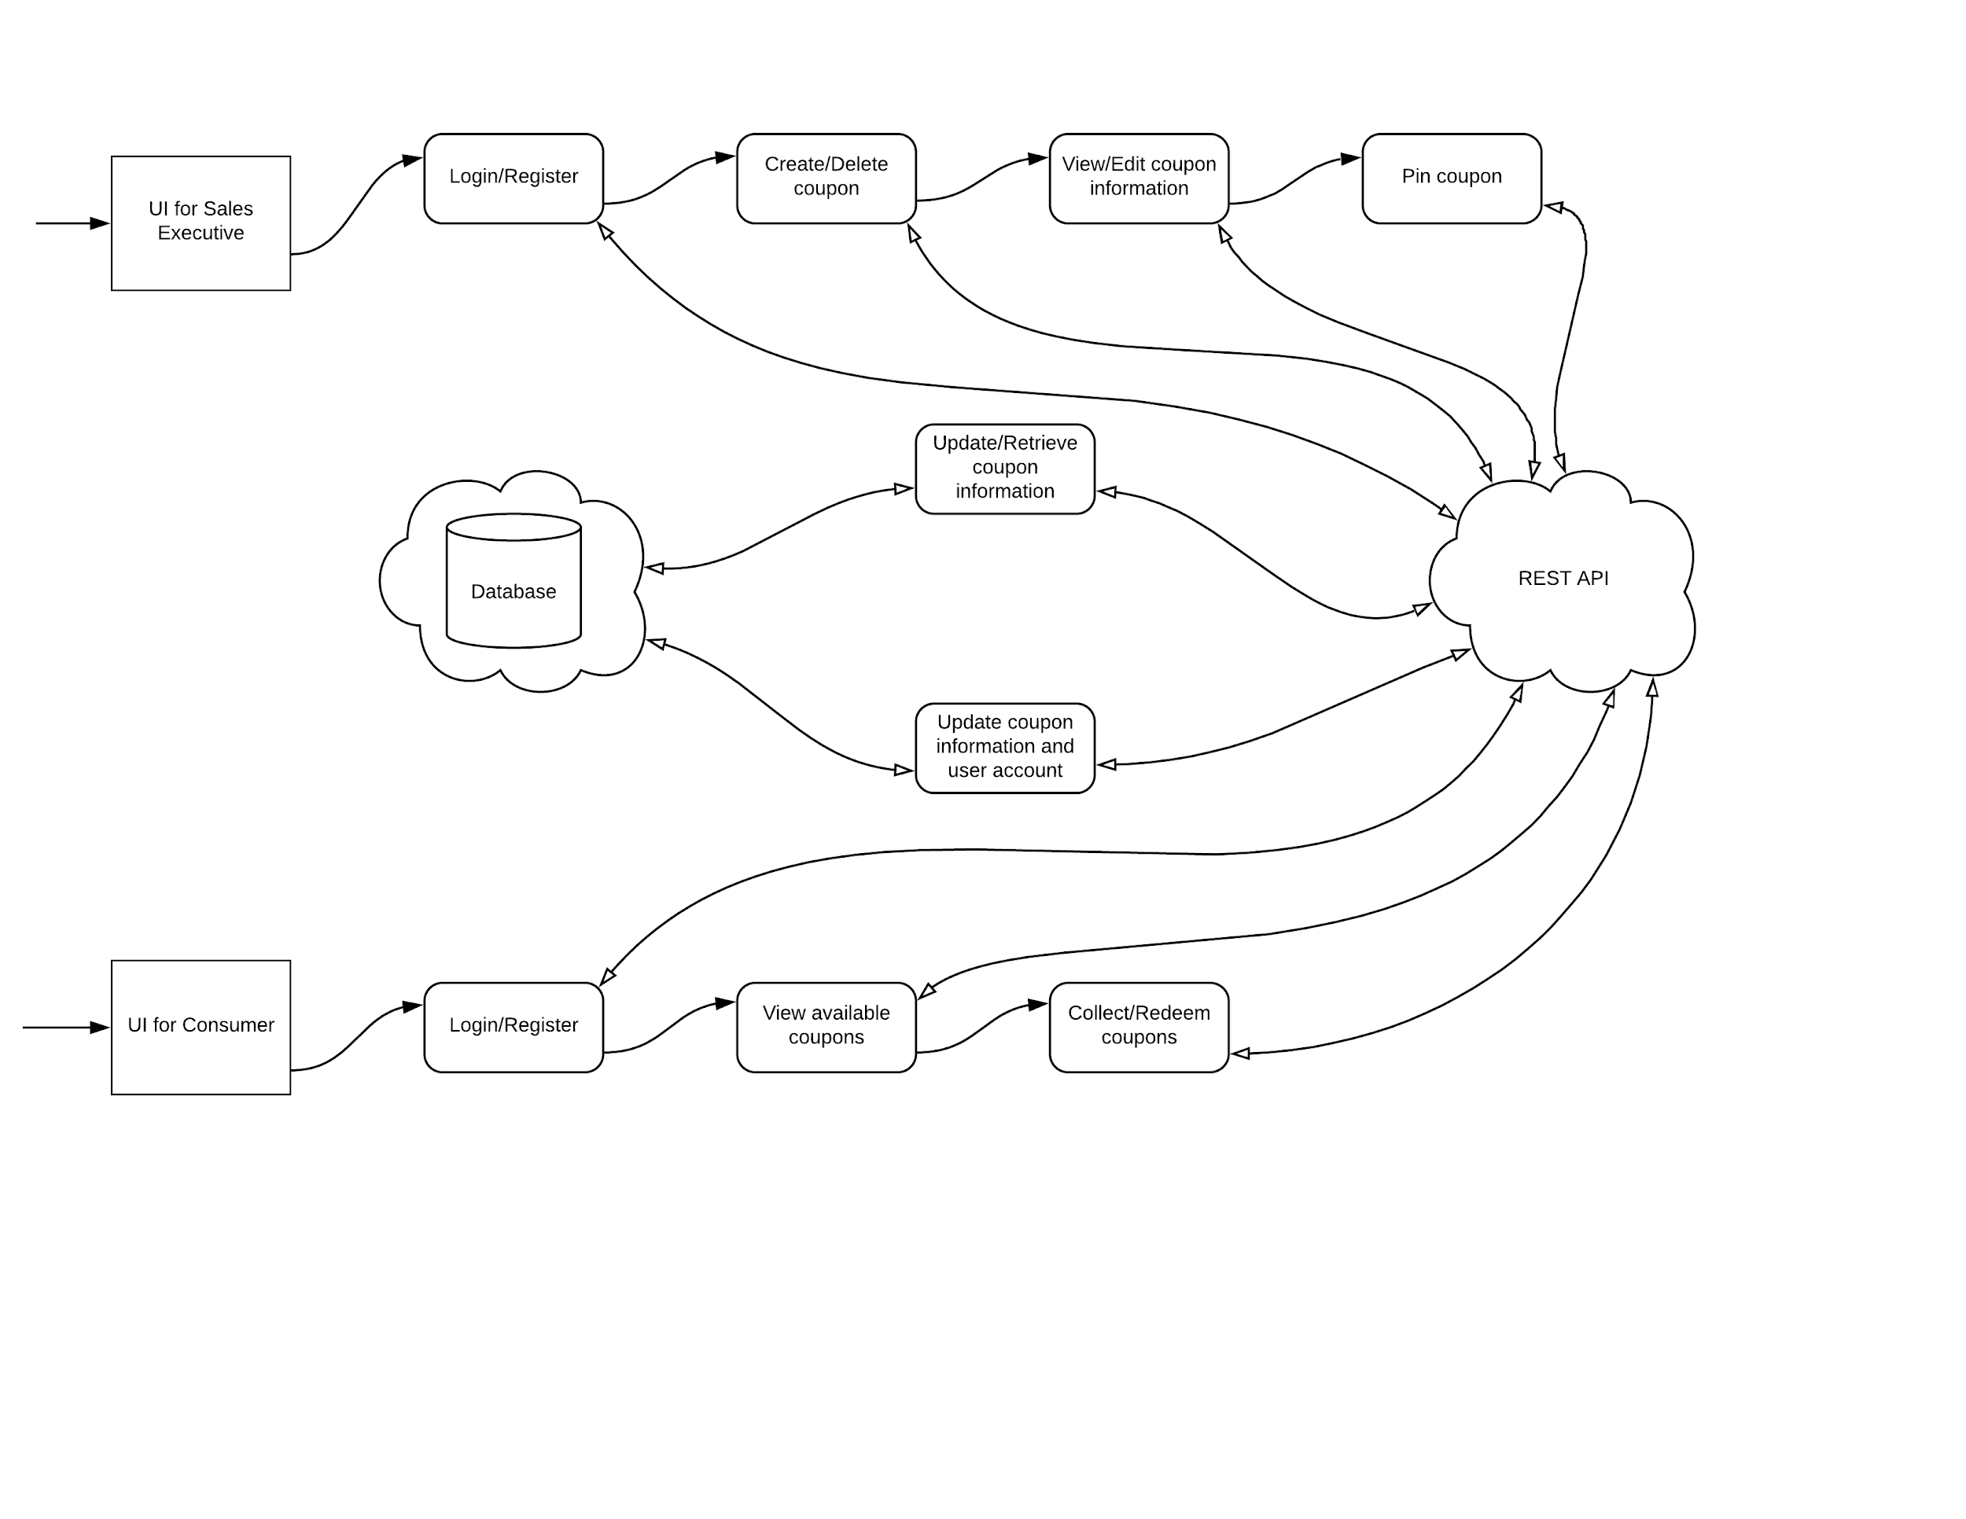
System Models
Database
  Storing coupon data
  Storing User data
Server
  Implementing complex logic
  Interacts with database, inserts, queries, and deletes documents
  Flows data from database to the client.
Client (UI)
  Takes information from server and displays them on the platform (Mobile/Web)
Notes:
Preston: I’ll talk about this if no one else does. (Life cycle of coupons)

Slide 21
System Models - Database: Coupon Collection
Coupon Document:
ID: The Mongo-generated value that is unique to this document
Company: The ID of the company linked to this coupon
UPC: An optional scannable code stored as a string
UpperLatitude: a double value for the top of the box around the coupon
LowerLatitude: A double value for the bottom of the box around the coupon
WestLongitude: A double value for the left side of the box around the coupon
EastLongitude: A double value for the right side of the box around the coupon
  Query by location is around O(N) (without index), O(log(N)) with index.
PreViewingDate: The first date the coupon can be previewed (alerting the customers)
CollectStartDate: The date that the coupon is first collectable
RedeemStartDate: The date that the coupon is first redeemable
CollectionEndDate: The last date that the coupon may be collected
RedeemEndDate: The last date that the coupon may be redeemed
Description: Contains all the coupon details such as item inclusions/exclusions, combinability, etc.
Image: A picture that may be transmitted with the coupon
Template: An integer that specifies which layout this user is choosing for this coupon
Notes:
(Life cycle of coupons)
Mention that time complexity on Spatial queries on Mongo isn’t well defined but all recommend having an index for speed.

Slide 22
System Models - Database: User Collection
User Document:
ID: The Mongo-generated value that is unique to this document
FirstName: The user’s first name as a string
LastName: The user’s last name as a string
Email: The user’s email address
SignupDate: The day that this user signed up
UserType: The type of user this is (Admin, Retailer, Customer)
LastLat: The last latitude logged for this user
LastLong: The last longitude logged for this user
LastUpdateTime: The last time that the user reported their location or collected a coupon
CouponsCollected: An array of the object IDs for all the coupons they have collected so far
  Takes O(N) to query.
AuthenticationToken: The token used by Retailer users in order to create their account
Notes:
(Life cycle of coupons)
Should mention that for coupons collected, we are deciding on storing on front-end and occasionally syncing it to the database.

Slide 23
System Models - Database: Company Collection
User (Company) Document:
ID: The Mongo-generated value that is unique to this document
CompanyName: The name of the company as a string
Email: The contact address for the company’s main user
SignupDate: The day that this company first signed up
AvailableUserTokens: An array of authentication tokens that have not been claimed by users
UsedTokens: An array of authentication tokens that have been claimed by users
Notes:
(Life cycle of coupons)

Slide 24
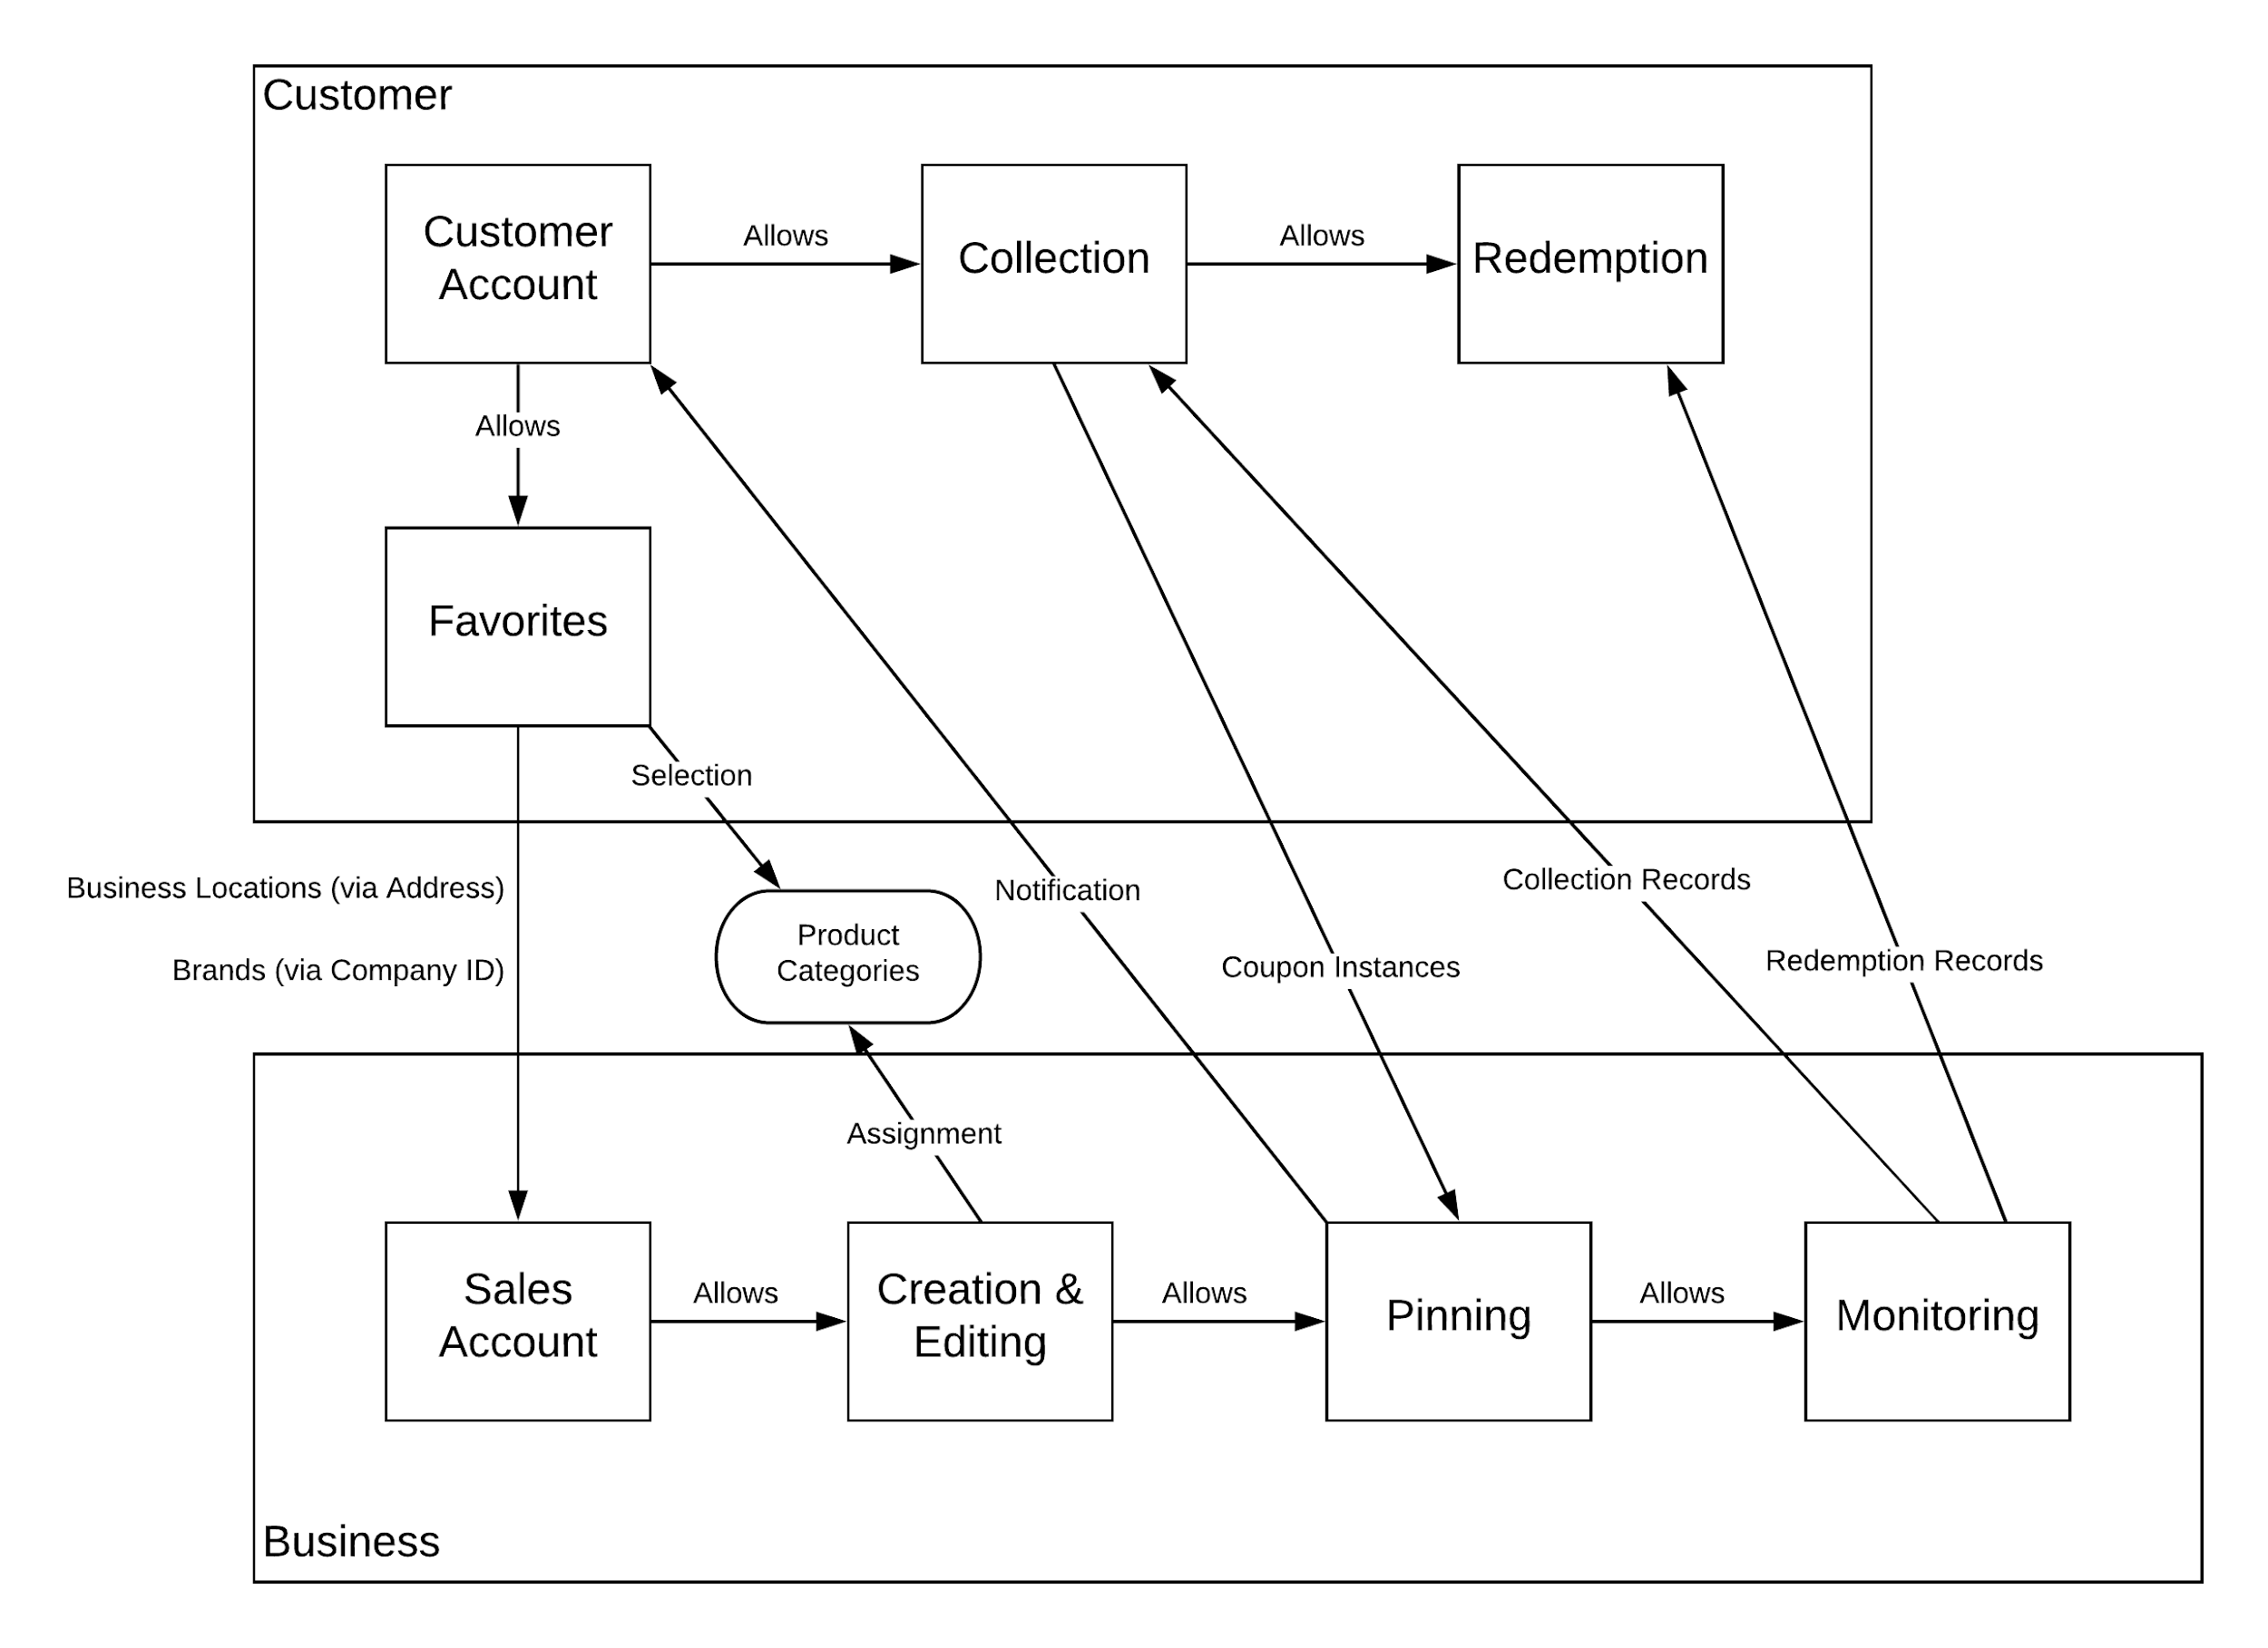
Sub Systems:
Customer Account
Collection
Redemption
Favorites
Sales Account
Creation & Editing
Pinning
Monitoring
Notes:
Nathan

Slide 25
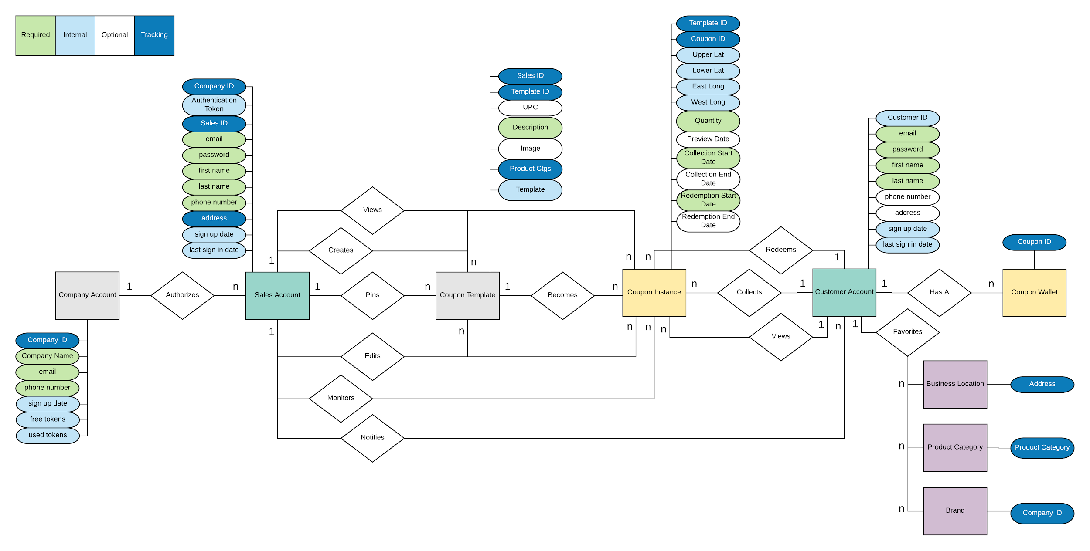
Notes:
Nathan

